Slide 1


Slide 2

Medical Vitals vs Financial Vitals
Notes:
Similar to medical vital signs doctors use to understand how healthy you are and where to look further when you have a problem, we have created vital signs for your finances. There hasn’t been a way previously to know how you are doing financially and there isn’t anything out there to easily help you know how you are doing for your stage in life.

Slide 3
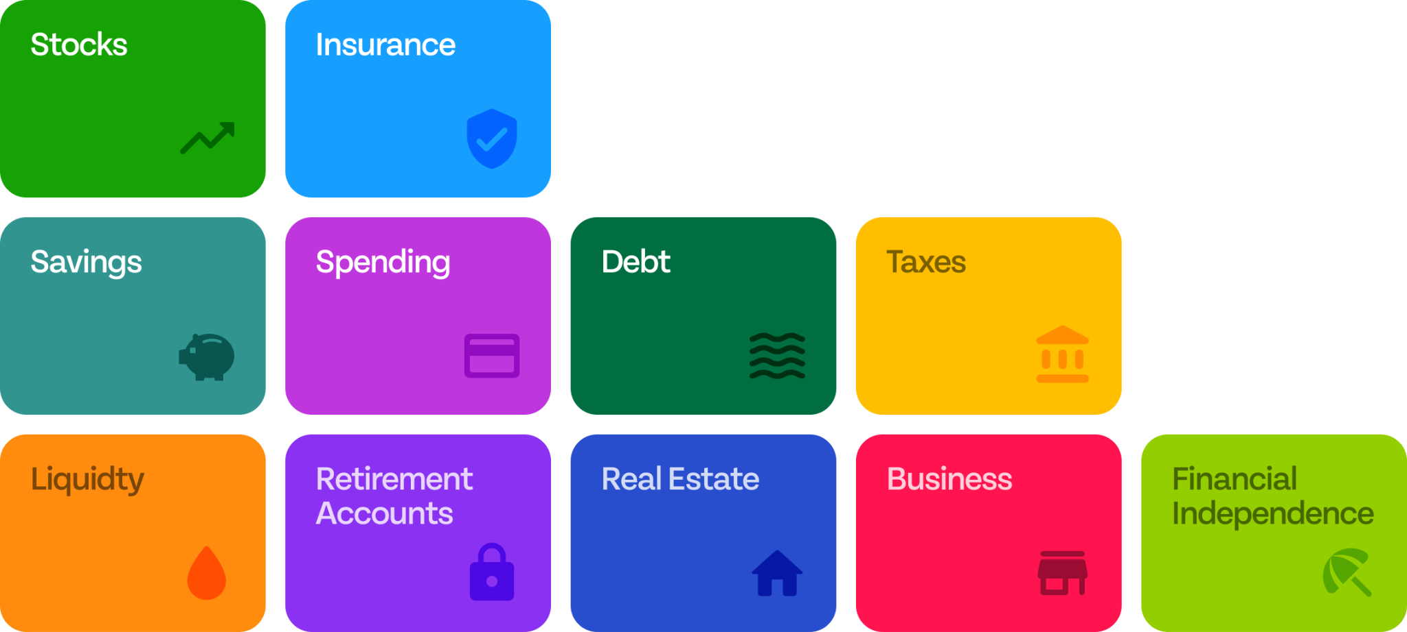
Financial Vitals.
Notes:
Our system helps you understand and learn the financial vital signs you should track over time to understand how you’re doing, and avoid problems that can arise inadvertently, similar to Tom.
There are alot of different aspects to your financial life… most of which are represented here.
Monitoring and tracking your progress over time will:
Increase awareness and accountability
Increase your confidence
No score is bad, it just is
All scores can improve and result in stress reduction.
Today we are going to learn about one of them: Debt Rate

Slide 4
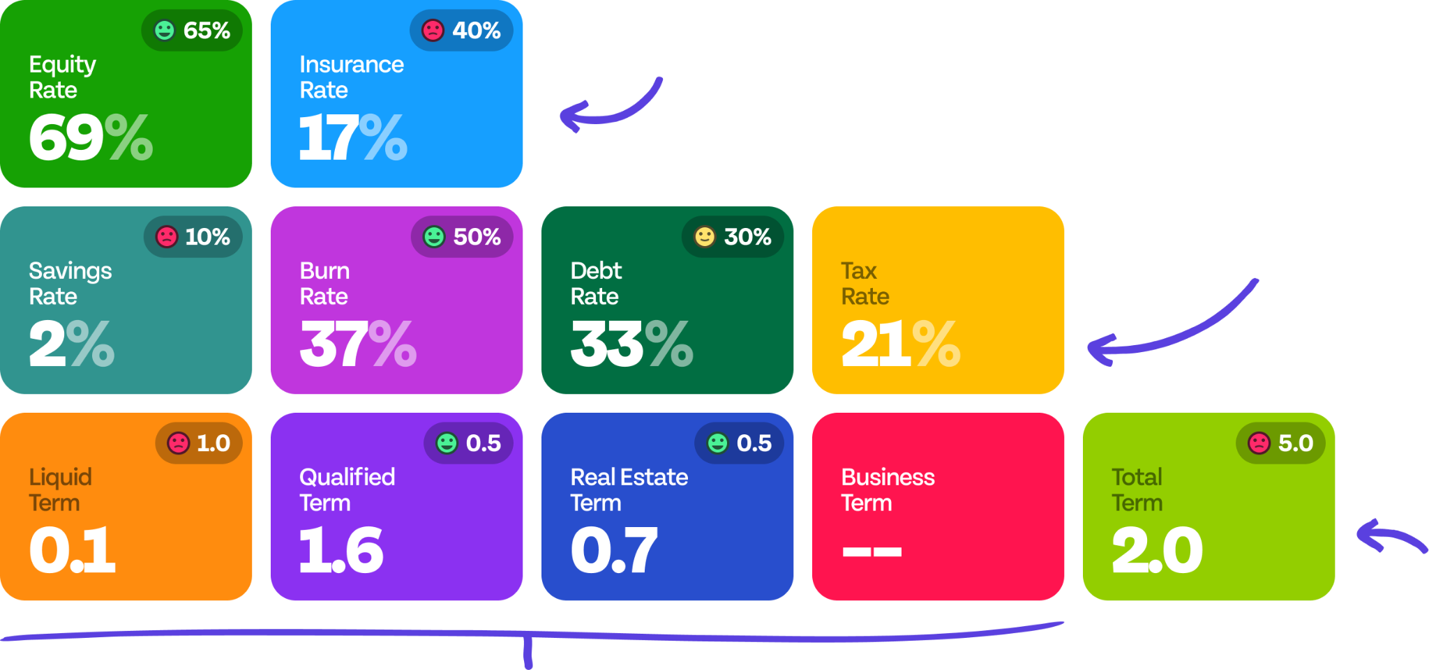
Your Financial Vitals
Risk Profile
Cash Flow
Retirement
Asset Mix
Notes:
Go into the product: Jane Bell on the advisor profile - Elements of Money Show firm.

Slide 5
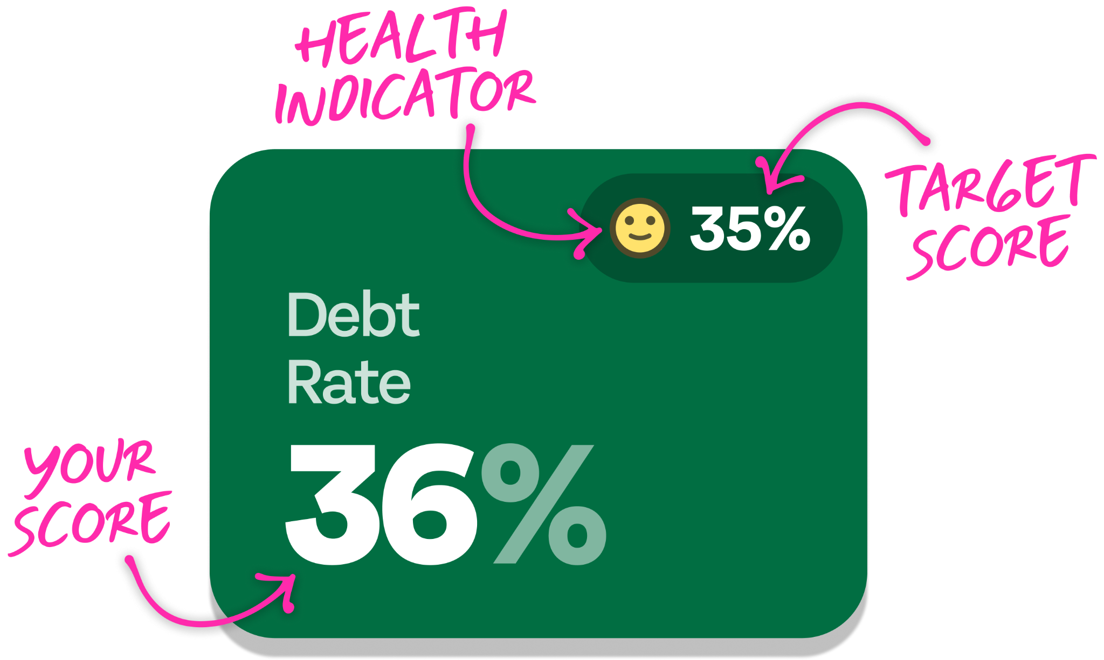
Reading your vitals.

Slide 6
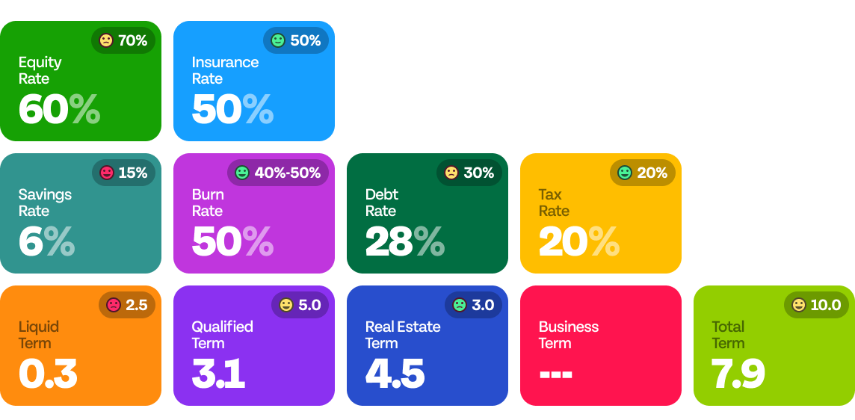
Your Vitals.
Notes:
Use Pollanywhere to have them click on the questions that are most relevant to them.
Zoom can also do polls for the workshops that are virtual
Questions:
Emotional:
Am I doing ok?
Am I doing enough to save for retirement?
How am I ever going to understand my money? <or> How do I improve my financial literacy?
I feel stressed about my financial situation and don’t know how to improve it.
Savings:
How much should I be saving each month?
How do I balance saving and enjoying my life now?
How should I save for a down payment for a home?
How much should I save for emergencies?
How do I save for my children’s education?
Debt:
Am I paying too much in debt?
Should I pay off debt or invest?
How much of a home can I afford?
What's the best way to pay off credit card debt?
Should I lease or buy a car?
How do I get rid of my debt as fast as possible?
Spending:
Am I spending too much?
Should I be following a budget?
How do I set up a budget?
What's the best way to track my expenses?
Insurance:
Do I have enough insurance coverage?
Do I need a life insurance policy?

Slide 7
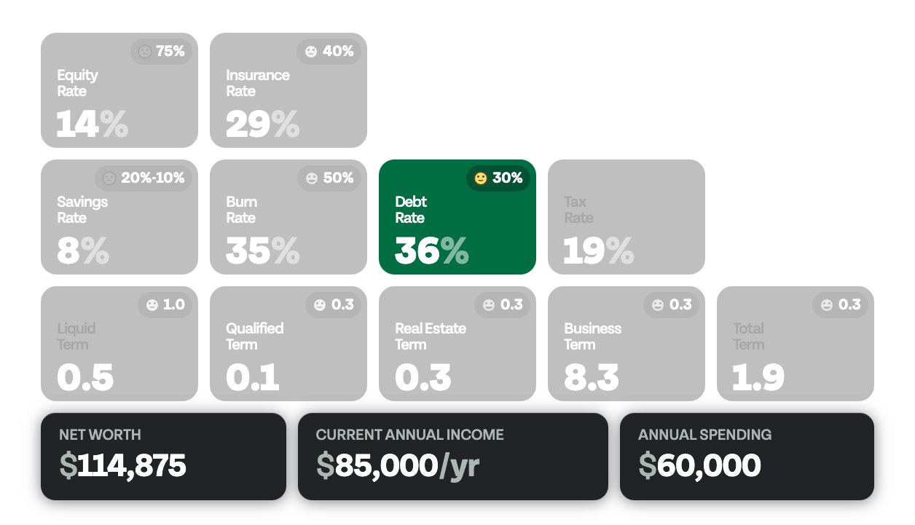

Slide 8

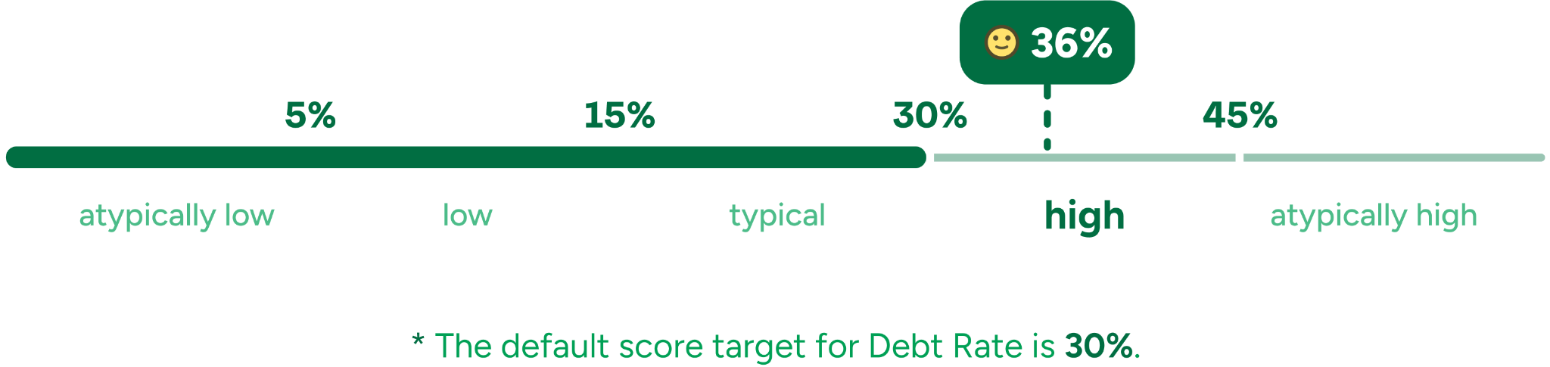
Calculating Your Debt Rate
Annual Debt Payments
$30,600
36%
Total Personal Income
$85,000
Notes:
When should I refinance?

Slide 9
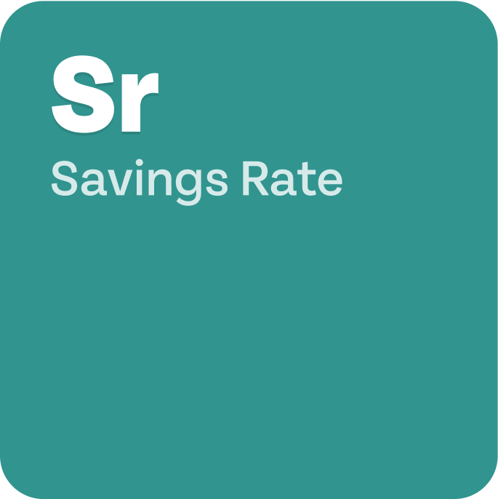
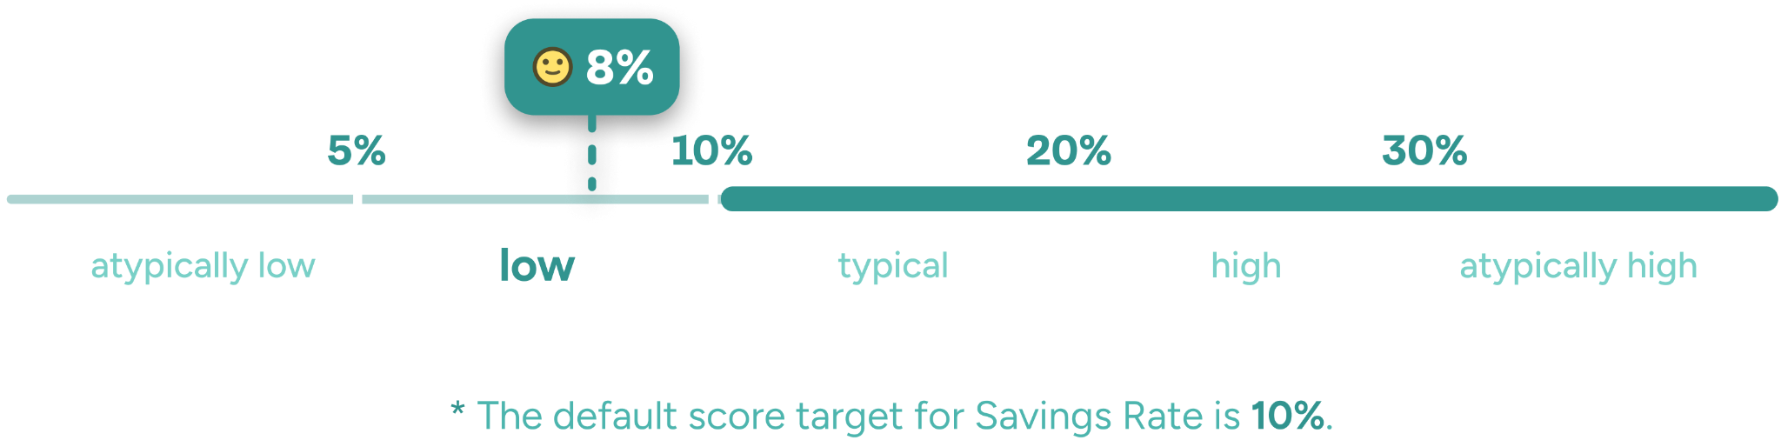
Calculating Your Savings Rate
Total Annual Savings
$6,800
8%
Total Personal Income
$85,000
Notes:
When should I refinance?

Slide 10

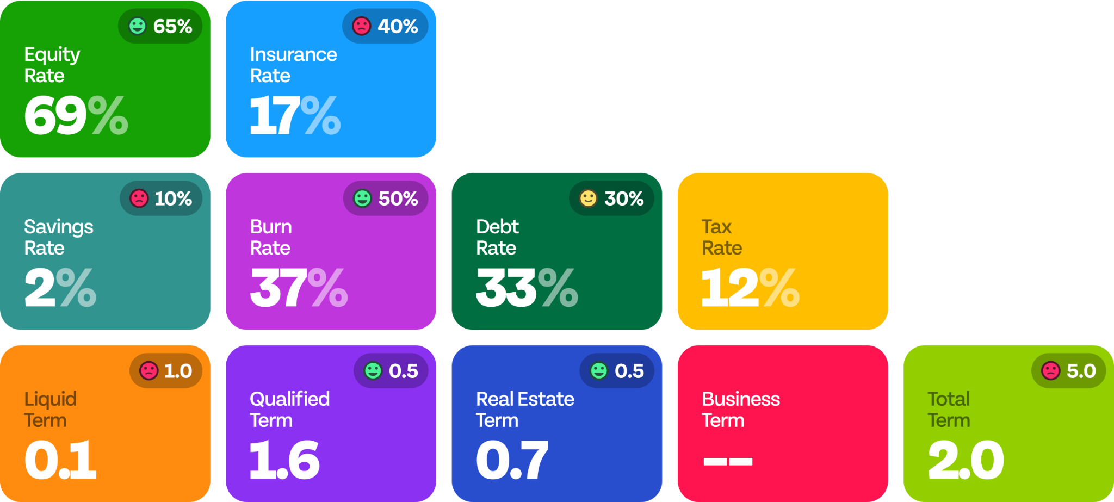


Nick & Jackie Northrup
Age 38 | Age 35
Net Worth
Annual Income
Annual Spending
$114,875
$85,000
$60,000
Notes:
Where should we put our money?
Tr = 13%
Sr = 8%

Slide 11
What are your questions?
How do I save for kids’ educations?
Is real estate a good investment?
How do I pay less taxes (legally)?
Should I pay down debt or invest?
Where should I keep my rainy day fund?
How can I pay down my mortgage faster?
What affects my credit score?
How do I invest my money?
Buying vs. leasing?
How much do I need to retire?
How am I doing financially? Am I OK?

Slide 12

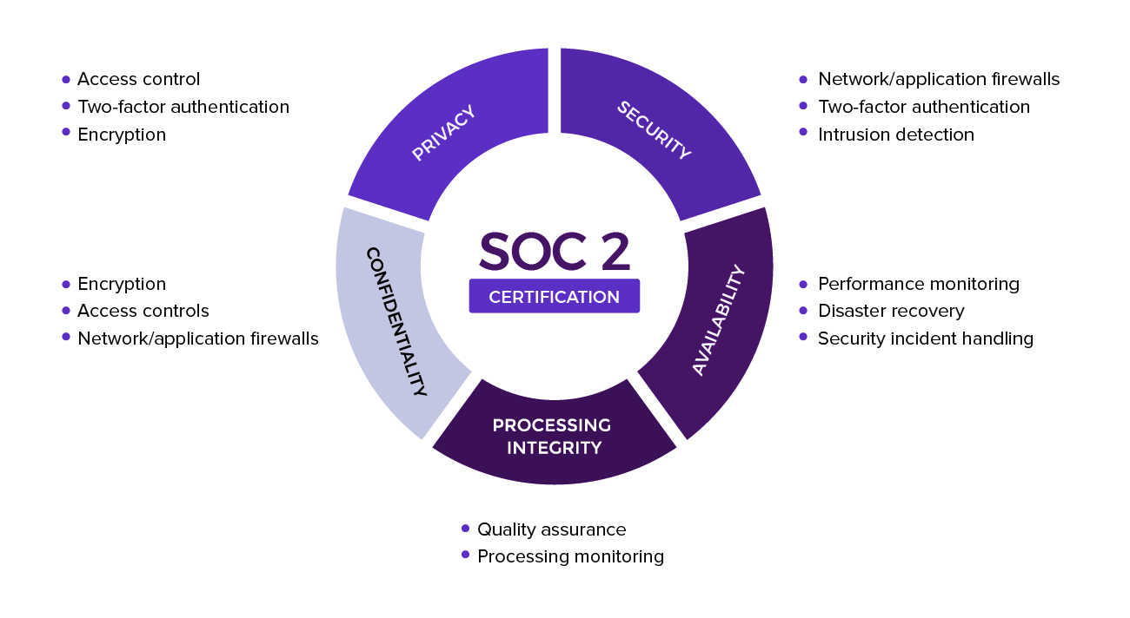
Your Data is Secure with Us
Notes:
Our system helps you understand and learn the financial vital signs you should track over time to understand how you’re doing, and avoid problems that can arise inadvertently, similar to Tom.
There are alot of different aspects to your financial life… most of which are represented here.
Monitoring and tracking your progress over time will:
Increase awareness and accountability
Increase your confidence
No score is bad, it just is
All scores can improve and result in stress reduction.

Slide 13

Interactive Poll
Join at
slido.com
#3734 800
Notes:
Now we’d like to know what common financial questions you have so that we can use them to show you how Elements can help.
To see results: https://admin.sli.do/event/7mRgVxfuV6YuCtFqxwKyvq/polls

Slide 14

Get started now.

Slide 15
Get Started Now
Schedule a coaching session:
[your URL here]

